Slide 1
Purchase
Dynamics NAV
Copyright Microsoft, Modified by Instructor

Slide 2
Lab - Create a New Item
Item No. Next in the default number series (Paint)
Description UMB
Unit of Measure PCS
Costing Method FIFO
Unit Cost 11.50
Price/Profit Calculation Price=Cost+Profit
Profit % 35
General Product Posting Group RETAIL
Inventory Posting Group RESALE
Replenishment System PURCHASE

Slide 3
Lab: Create New Vendor
SchoolColors Paint Company
Contact: Sydney Carton
100 JFK BLVD, BOSTON, MA
Invoicing
  Gen. Bus. Posting Group → National
  Vendor Posting Group → Domestic
Payment
  Manual
  14Days (Payment Terms Code)
  Code: Check Payment
Receiving
  Location: Blue

Slide 4
Purchase Order
Buy “UMB” from “SchoolColors Paint Company”
  Open New purchase order, Select Vendor
  Check ‘Document Date’ and ‘Due Date’
  Select “UMB” Item
  Quantity 200, Direct Unit cost 10$
  Location – Blue
  Check Qty to Receive and Invoice fields
  OK

Slide 5
Purchase Order Contd.
After receiving goods
  Open the purchase order you just created
  Post – Receive and Invoice
  Need Vendor Invoice No. to Post – 343456
    This is the invoice document id sent by Vendor
  What happens to Purchase order?
    It becomes posted documents

Slide 6
Purchase Order Contd.
Purchase Order becomes (see Posted Documents in Navigation Pane)
  Posted Purchase Invoice
  Posted Purchase Receipt
  Note: Posted documents are not editable?
How is this going to effect Vendor?

Slide 7
Vendor Contd.
How is this going to effect Vendor?
  Select Vendors – SchoolColors Paint Company
  ‘Home’ Ribbon – History – Ledger Entries
  What is External Doc No.?
  Check the Amount due…
How is this going to effect Item?

Slide 8
Item Contd.
How is this going to effect Items?
  Select Item purchased
  Check Qty on Hand
  Go to ‘Navigate’ Ribbon–’History’ Tab - Entries – Ledger Entries
    What do you see?
    Select your purchase line, and click ‘Navigate’ on ‘Home’ Ribbon.
    Notice the purchase details

Slide 9
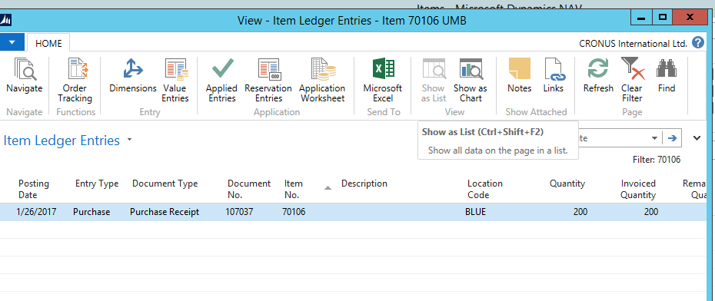

Impact on Item

Slide 10
Pay the Vendor
We are going to pay the vendor for the items received.
Search for ‘Payment Journals’ in NAV
Default is ‘Bank’ Batch
Posting date – choose past purchase order date
Document type – payment
Document No – put some random number like 123 (could be the check number we generate)
A/C Type – Vendor
A/C No – choose the vendor we are paying
Applies to doc – Invoice
Applies to doc no
  This should open up all outstanding amounts from the selected vendor. Choose the right invoice (you should only have one invoice, unless you placed many orders)
‘Post’ the line. Important step!

Slide 11
Crosscheck the payment
Crosscheck the payment by checking vendor balance (Vendor Ledger Entries)
  You can use the ‘Navigate’ function to see related records.

Slide 12
